Slide 1
Best Practice Analytics Part 3 – Machine Learning and Model Selection
Notes:
Security classification options: – Public
– Internal
– Confidential
– Highly Confidential

Slide 2
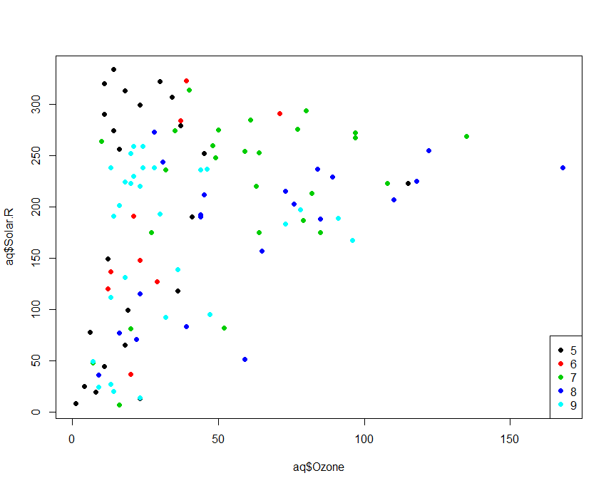
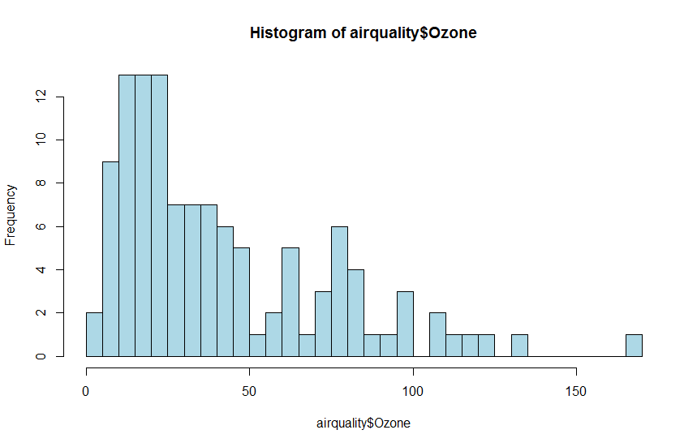
Exploratory Data Analysis and Pre-processing
Before you start modelling
Check distributions of variables
Find and remove outliers
Check and treat missing values
Use exploratory data analysis to inform feature selection
Find outliers
Check distributions

Slide 3
Feature Selection and Interpretation
Keep features (variables) that are highly correlated with the outcome (class).
Keep features with high variance
Remove features that are correlated with other features (multi-collinearity).
For example, consider that the ground truth model is Y=X1+X2.
If the data has reasonably small noise levels a linear regression would recover this model.
However, if X1 and X2 are collinear, i.e. X1 = a*X2 then each of these are equivalent outcomes in terms of error: Y=2*X1 or Y=3*X1-X2 or Y=100*X1-98*X2
The outcome is difficult to interpret
Use domain understanding to compute new features, especially if you use linear models (e.g. fraud detection domain: billing address = shipping address, transaction < £30)
You can use principal component analysis (PCA) to create features that are uncorrelated and preserve maximum variance, but they can no longer be interpreted in the model.
Do not take the weight of a feature in a linear model as its importance (see also standardisation)

Slide 4
Model Building
Split your data into training and test. Lock away your test data and don’t look at it until the end.
Split your training data into training and validation (optional).
Use training data to train your model. You can check how the model performs on individual input patterns.
Use validation data to do hyper-parameter optimisation. Only look at the business metric relevant to your project, don’t look at behaviour on individual data.
When you have made a decision which model you want to deploy use the test data to make a go/no-go decision. You can never use this test data again. If you need to iterate you will need new test data.

Slide 5
Model Building: Cross-Validation
1
Train
2
Train
3
Train
4
Train
5
Test
6
Train
7
Train
8
Train
9
Train
10
Train
Randomly split your data into K subsets (folds). Typically, we pick K=5 or K=10.
Keep one fold for testing and train the model on the other (K-1) folds. Repeat K times, each time keep another fold for testing (picture above shows step 5 out of 10).
The average error across all runs is the estimate for the average expected error on unseen data.
Build the final model using all data.
Careful: all modelling steps, including feature selection must be part of the cross-validation. That includes any step that used the class information. Otherwise the error is underestimated.
You can execute unsupervised steps before cross-validation, i.e. pick features with high variance. “Unsupervised step” means that the class information is not used.

Slide 6
Cross-Validation Caveats
If you have only a small amount of data, cross-validation can over-estimate the error.
If K=N (size of data) you have 1-leave-out validation. This is useful for small data sets and does not over-estimate the error, but the error variance can be over-estimated.
Cross validation tells you something about the expected error of your modelling method. You can use it to pick a preferred method.
“Method” can mean the way you pick the model parameters or different modelling approaches (e.g. tree vs. neural network).
If you have vastly different outcomes in different runs, your data selection strongly influences the modelling results. Check if you have enough data.

Slide 7
Standardisation and Regularisation
When using linear models like logistic regression
Standardise your data, i.e. make sure all variables have the same numerical range, e.g. [0,1] or [-1,1]
Use regularisation, i.e. keep the model parameters small.
In regression that is known as ridge regression or L₂ regularisation. The squared values of the parameters are minimised in addition to the error.
Standardisation avoids that a single feature can dominate the model
Regularisation keeps the model simpler and avoids overfitting.

Slide 8
N<<p
If your number of parameters (p) in your model is much larger than the number of samples (N) in your data you need to be careful.
Many features lead to many tuneable parameters in your model. If you have many features but not many samples, use a model with few parameters to avoid overfitting.
For example avoid models like support vector machines (SVM) or neural networks.
Put more effort into feature selection.
Use regularisation and cross-validation.

Slide 9
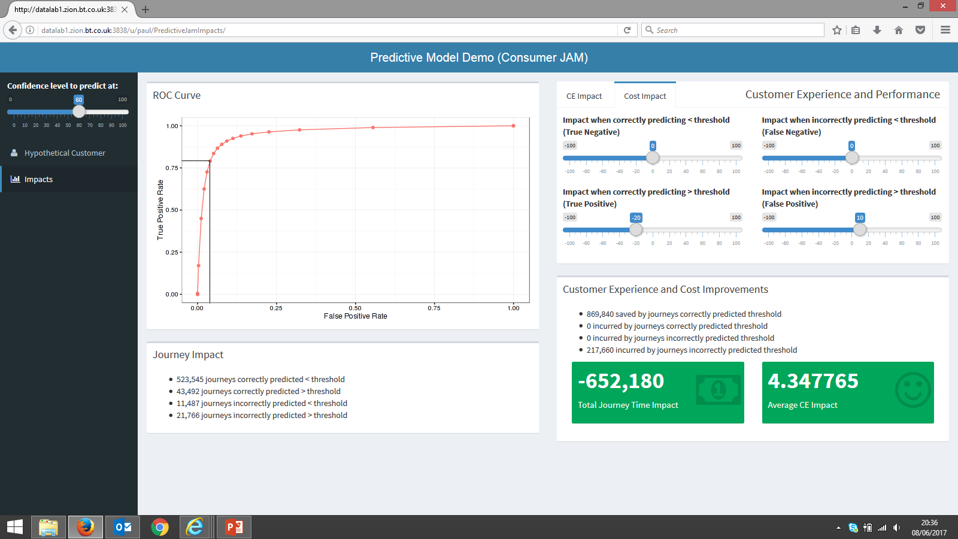
Finding a Good Operational Point for a Predictive Model We can operate a predictive model at any confidence level that gives us the best trade-off between improvement and cost

Slide 10
Performance Indicators for Classifiers
Confusion Matrix
 |  | Model
 |  | Yes | No
Data | Yes | True Positive (TP) | False Negative (FN)
 | No | False Positive (FP) | True Negative (TN)
All Data: N = TP + FN + FP + TN
Accuracy: (TP + TN) / N
Error: (FP + FN) / N = 1 - Accuracy
True Positive Rate (Detection Rate, Sensitivity, Recall, Benefit): TP / (TP + FN)
False Positive Rate (Fall Out, Extra Cost): FP / (FP +TN)
True Negative Rate (Specificity): TN/(FP+TN) = 1 – FPR
Positive Predictive Value (Precision): TP / (TP + FP)
Negative Predictive Value: TN / (TN + FN)
False Discovery Rate: FP / (TP + FP) = 1 – PPV

Slide 11
Cost Matrix Instead of Accuracy
 |  | Model
 |  | Yes | No
Data | Yes | TP * benefit of treating a positive | FN * cost of missing a positive
 | No | FP * cost of treating a negative | TN * benefit of finding a negative
Instead of training for a very accurate model, we can use a cost matrix to train for a beneficial model
Instead of maximising the model error, we maximise benefit and minimise cost.
The advantage is that we take the business case into account during model building.
A cost matrix can also account for a skewed class distribution (e.g. fraud, churn) where the positive class is much smaller than the negative class. However, you may still have to do resampling during the training phase to boost the smaller class.

Slide 12
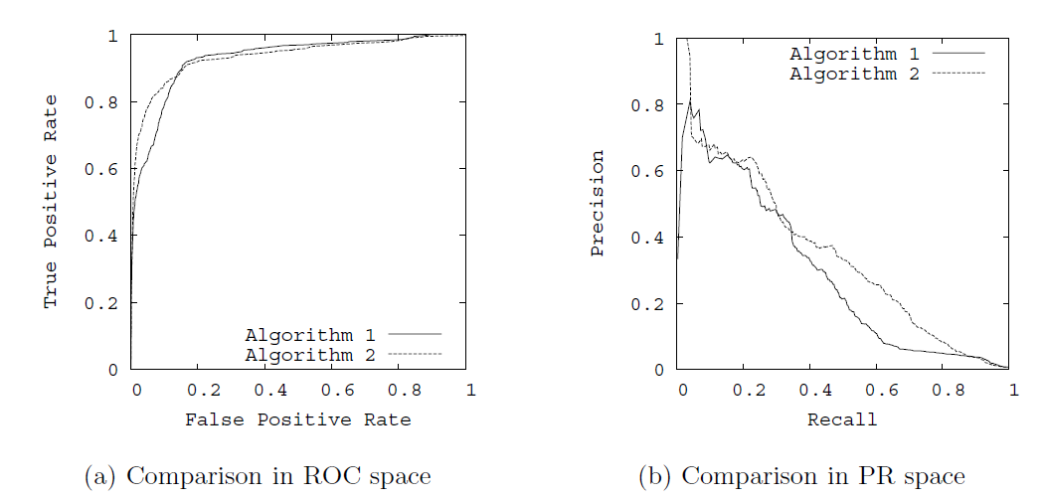
ROC Curve and Precision-Recall Curves
Recall
True Positive Rate
Source: Jesse Davis, Mark Goadrich: The Relationship Between Precision-Recall and ROC Curves. Proceedings of the 23rd International Conference on Machine Learning, Pittsburgh, PA, 2006 (http://pages.cs.wisc.edu/~jdavis/davisgoadrichcamera2.pdf)

Slide 13
ROC and PR Curves
The graphs are created by increasing the decision threshold for a classifier from 0 to 1 (assuming the classifier outputs values in [0,1] and is supposed to output a 0 for a negative case and a 1 for a positive case). For a non-numerical classifier you need to find a structural parameter you can vary (e.g. number of rules or nodes).
The ROC curves illustrates the trade-off between false positive rate (% of the model’s positives that are actually negatives) and the recall or true positive rate (% of the positives the model is catching). The ideal model sits at (0,1), i.e. the top left corner and gives an area of 1.0 under the curve. This model would find all your positives and make no mistakes, i.e. would also be 100% accurate.
The PR curve illustrates the trade-off between Recall (% of the positives the models is catching) and Precision (% of the model’s positives that are actually positives). This shows better how bad the situation is when you have drastically skewed class frequencies. The ideal models sits at (1,1), i.e. the top right corner and gives an area of 1.0 under the curve. This model would find all the positives and all the reported positives are actually positives. The model would also be 100% accurate.
The curves can be used to compare models or to find an operational point, i.e. a threshold for the classifier. This is point on the curve where gradient changes most noticeably and where the trade-off becomes worse.

Slide 14
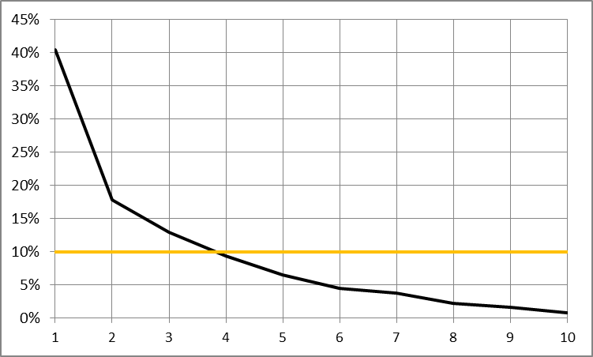
Example: Churn Model based on Logistic Regression Evaluated by Lift in Deciles
Sample: 1,127,794 with 10% churn (112,780)

Slide 15
Lift
The increase in performance of a targeting model against a random decision
For example, if your model produces a set of cases that contains x% positives (targets) while a random set would contain y% positives, then the lift is x/y (or x/y * 100 in %).
Often used for marketing models because you want to maximise the positive cases in a treatment set (mail shot or similar).

Slide 16
Deciding if a Model is Useful
Just quoting the accuracy of a model can be misleading especially in cases where the data is extremely skewed and the target class is rare (e.g. churn, fraud, faults, …). Example: if churn probability is 1% then a model that classifies everyone as non-churner is 99% correct but 100% pointless.
Using the lift also limits the information. If segment of data identified for a campaign (or treatment) has a lift of 4 (or 400%) then we know that the segment contains four times as many targets than a random set would. However we don’t know anything about the cost of using the segment in a campaign. Example: if churn probability is 1% then a set giving us a lift of 4 would contain 4% churners. If this set would be the top decile in our data (top 10% with highest churn risk), it would contain 40% of the churners, but 96% of the set would still be non-churners.
Ideally, we want to understand the trade-off between benefit and cost of a model which can be expressed in different ways depending on context.

Slide 17
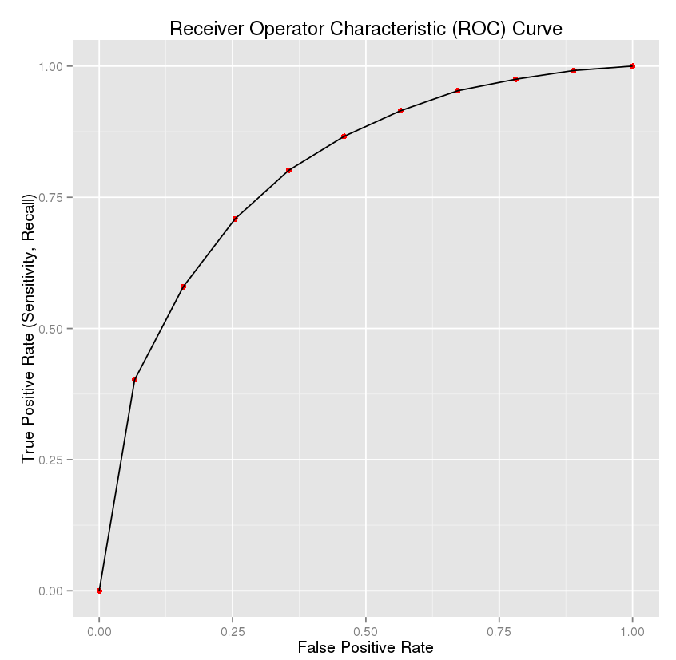
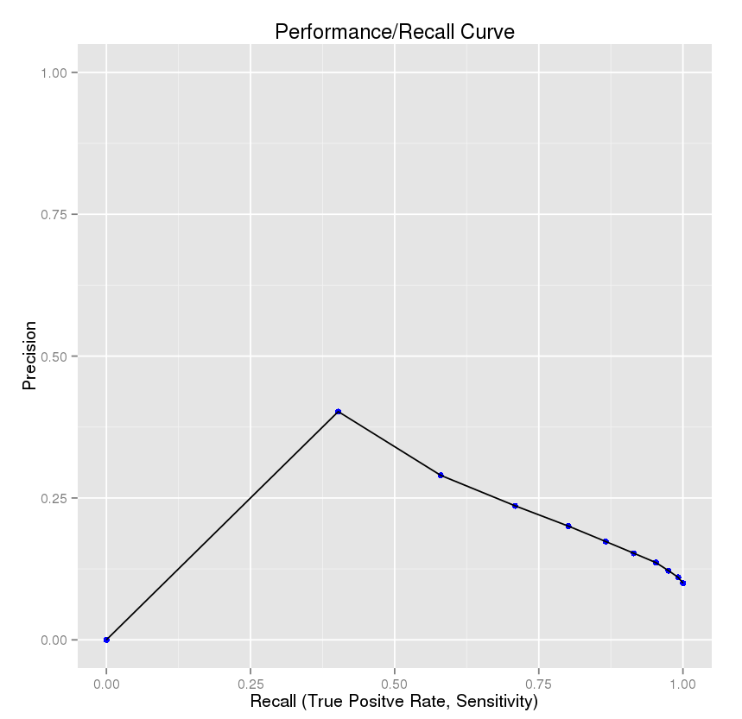
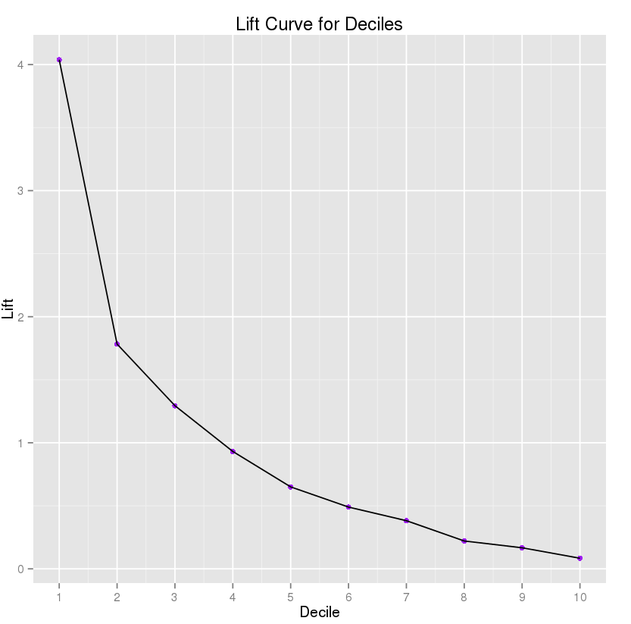
Example: Churn Model based on Logistic Regression Comparing ROC, Performance/Recall and Lift Curves
=Goal
Each point from left to right adds another decile and simulates a decision threshold. The origin represents a threshold that classifies nobody as a churner.

Slide 18
How to Compare and Select Models
You can pick the model that maximises the area under the ROC or PR curve
You can pick the model the gives the best operational point in the ROC/PR curves – e.g. where the gradient of the graph changes most noticeably.
You can pick the model that does best in cross-validation.
You can combine these criteria and add lift, operational cost, ease of implementation into the mix.

Slide 19
I do solemnly swear that I will never test on data that was involved in any way in training or validation.

